Slide 1
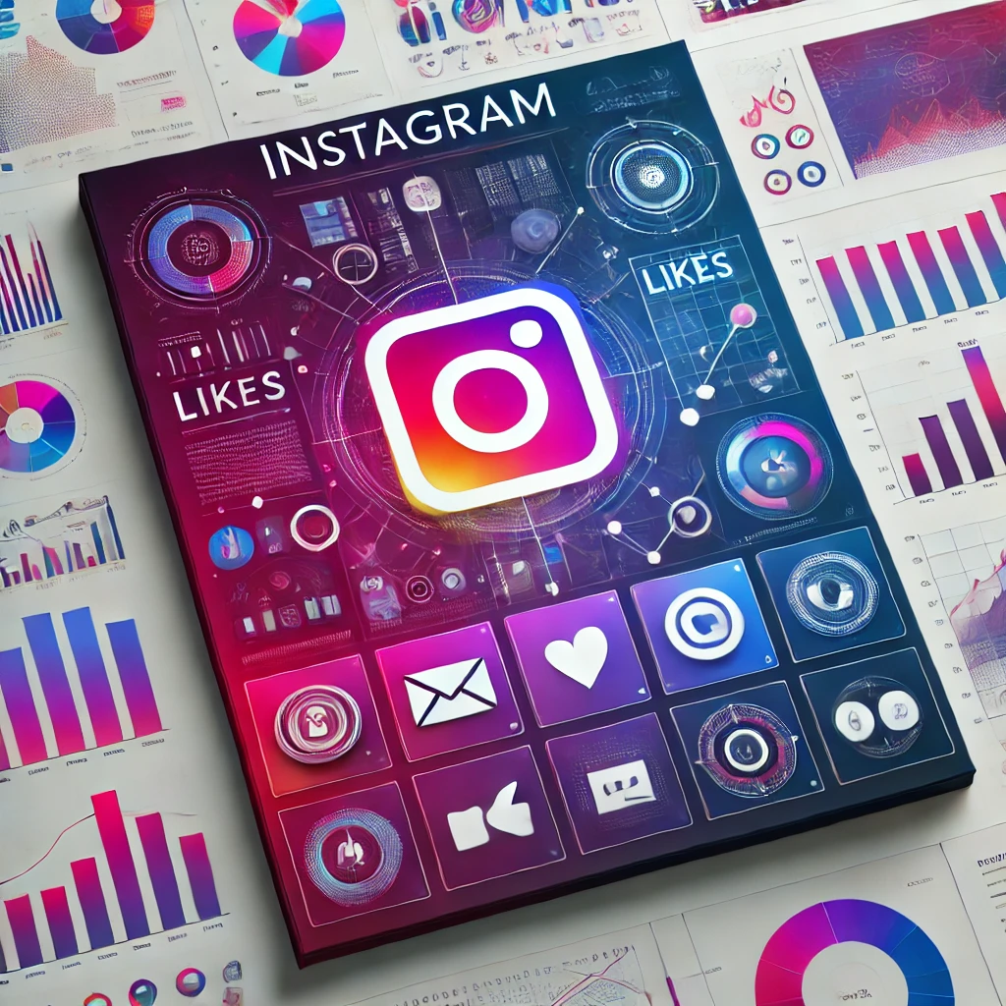
Social Media Project
Naveen H N
18/11/2024

Slide 2
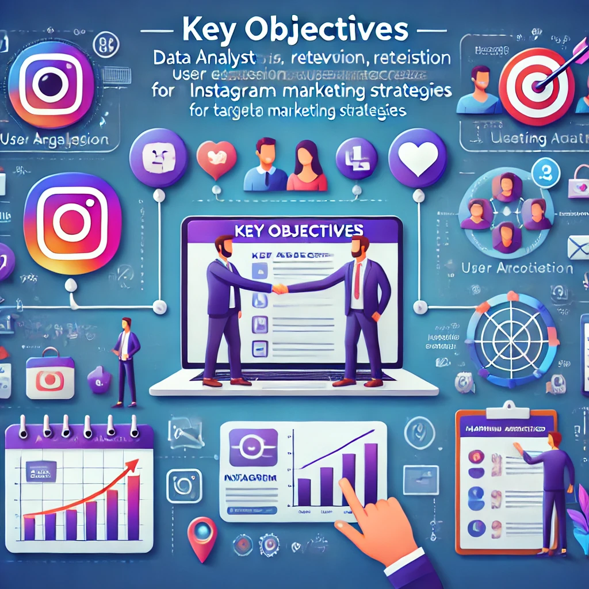
Introduction
Objective: Enhance user engagement, retention, and acquisition through data-driven marketing strategies.
User Insights: Analyze demographics, activity patterns, and preferences to understand audience behavior.
Personalization: Utilize data to create personalized ad campaigns and content tailored to user interests.

Slide 3
Introduction
Engagement Tactics: Implement targeted notifications, promotions, and interactive features to boost activity.
Retention Strategies: Identify high-value users and develop loyalty programs to encourage repeat engagement.
Acquisition: Optimize ad spend by targeting potential users based on similar profiles and interests.

Slide 4

Problem Statement
Introduction
You are hired as a data analyst at Meta and asked to collaborate with the Marketing team. Marketing teams want to leverage Instagram's user data to develop targeted marketing strategies that will increase user engagement, retention, and acquisition. Provide insights and recommendations to address the following objectives.

Slide 5
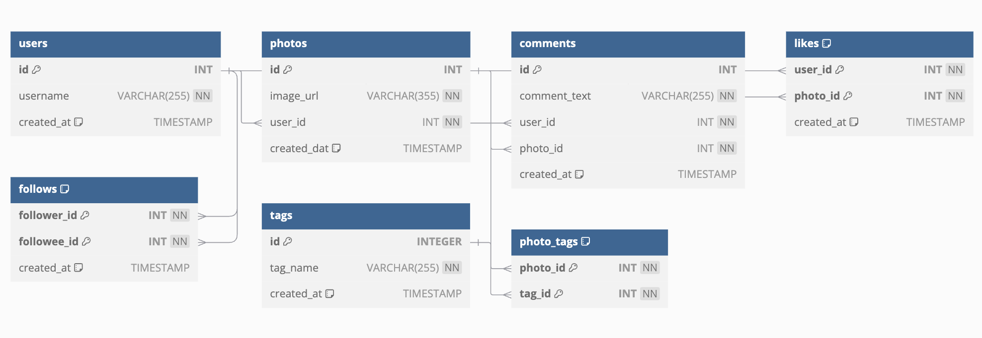
Schema Diagram
Introduction

Slide 6
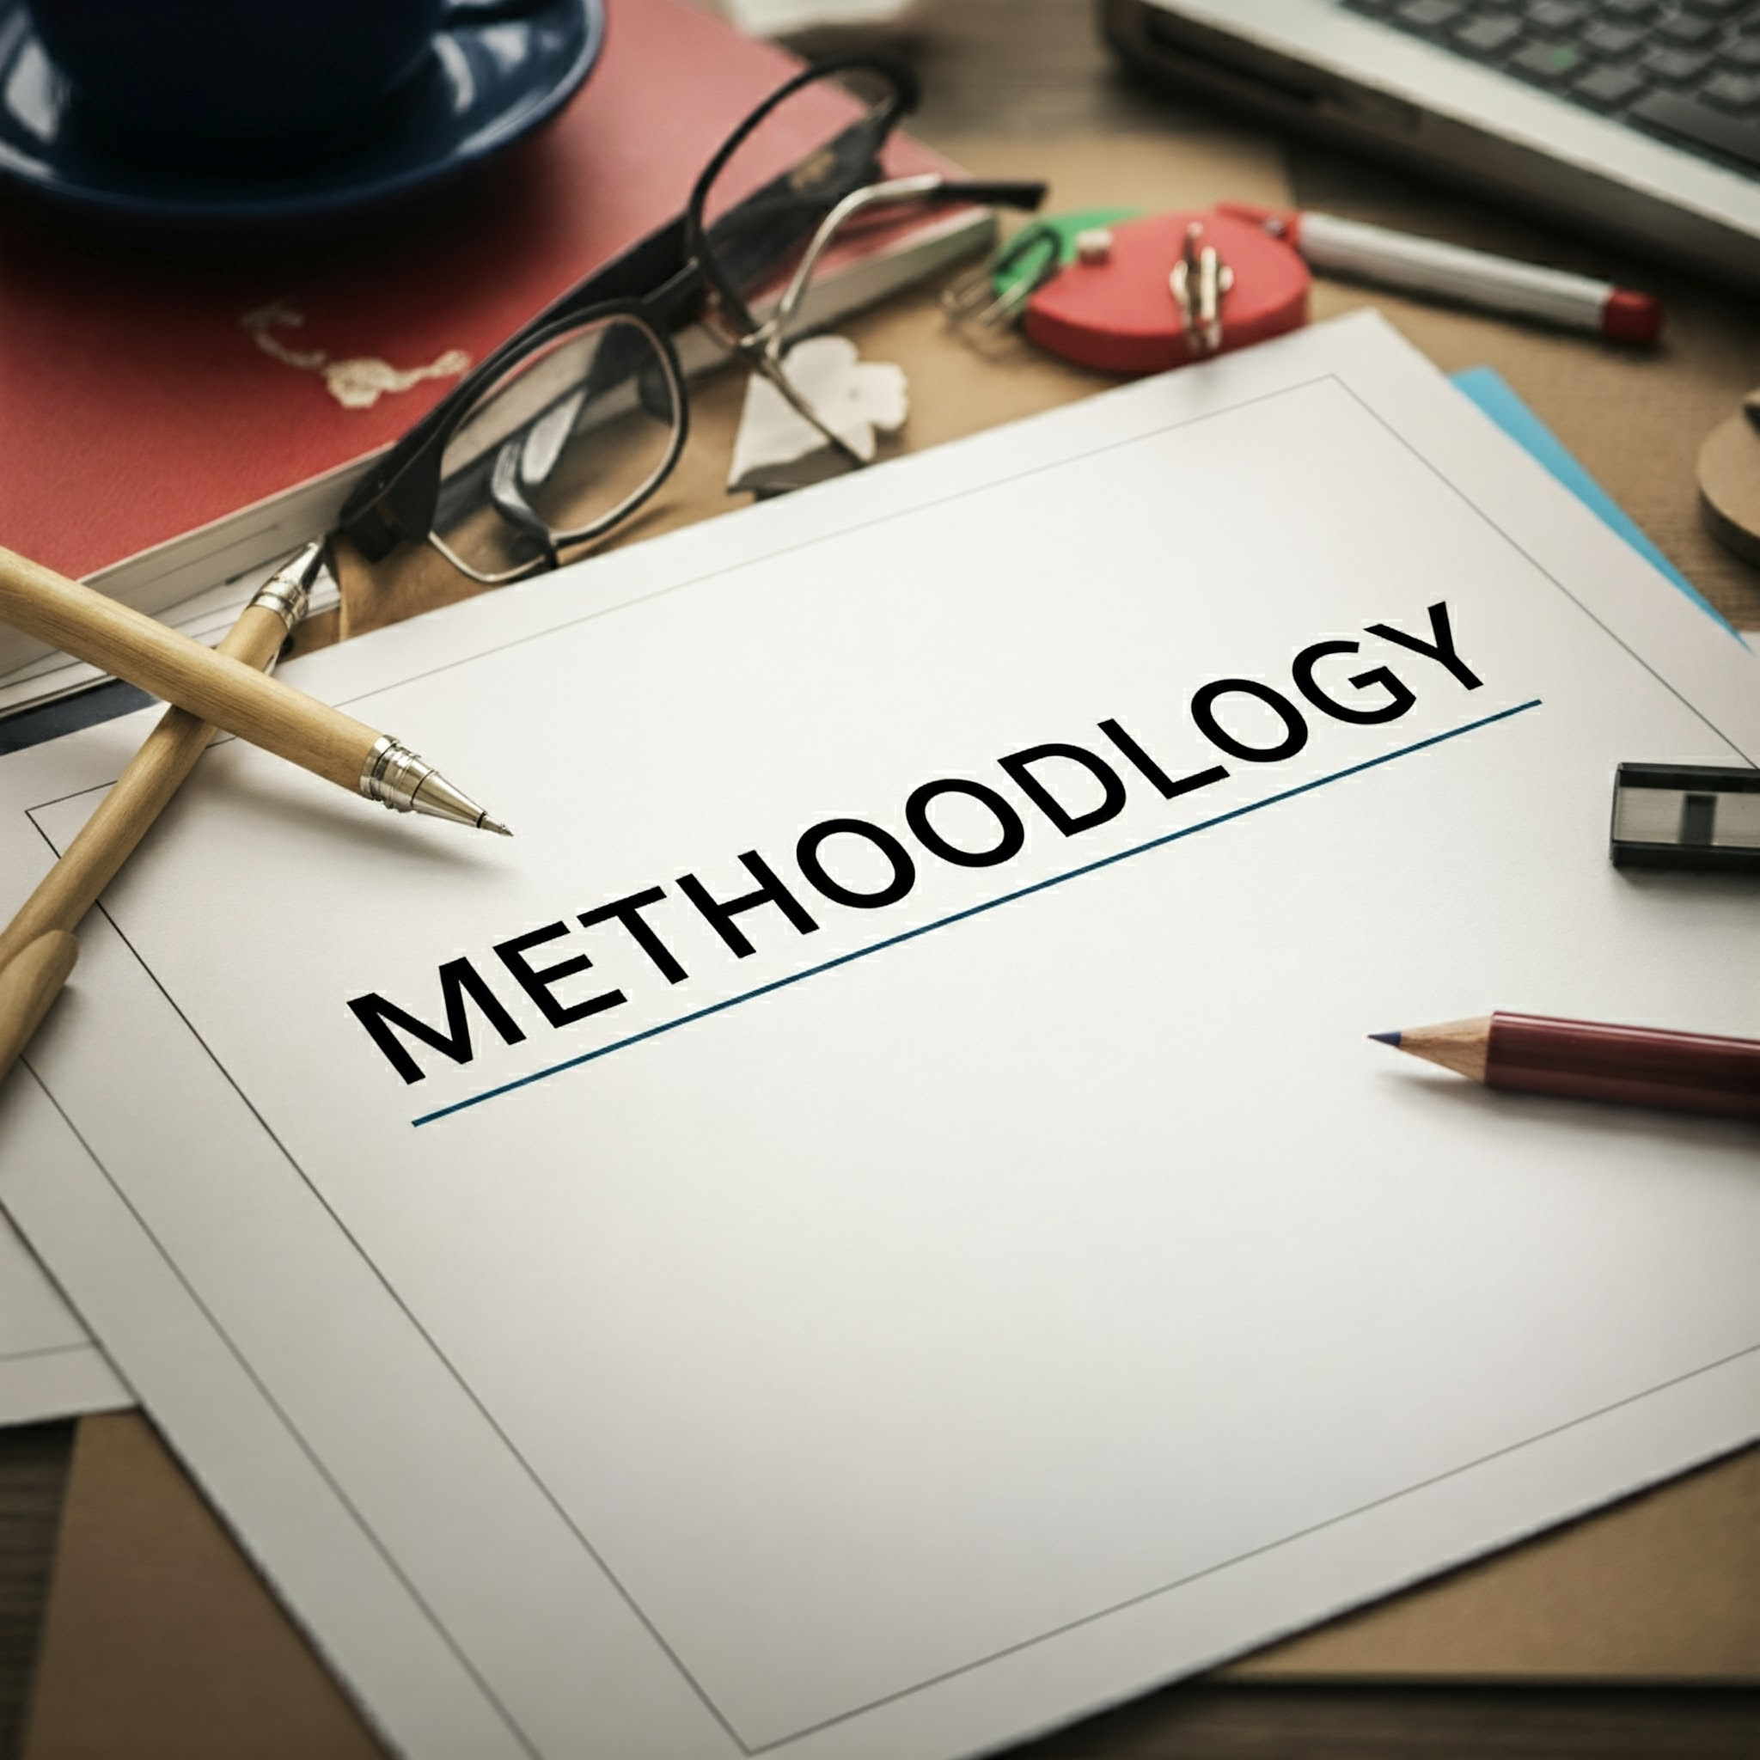
Methodology
Step 4
Strategy Development
Design targeted campaigns for engagement, retention, and acquisition.
Personalize content and ads based on user preferences.
Step 1
Data Collection
Gather Instagram user data (e.g., demographics, activity, preferences) via analytics tools and APIs.
Step 3
Insights Generation
Identify key user segments and their engagement drivers.
Analyze factors influencing retention and churn.
Step 2
Data Analysis
Perform segmentation to identify patterns and trends in user behavior.
Use machine learning models to predict user preferences.

Slide 7
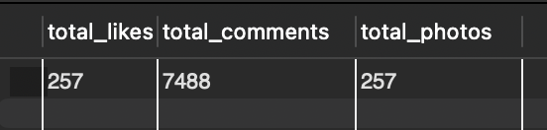
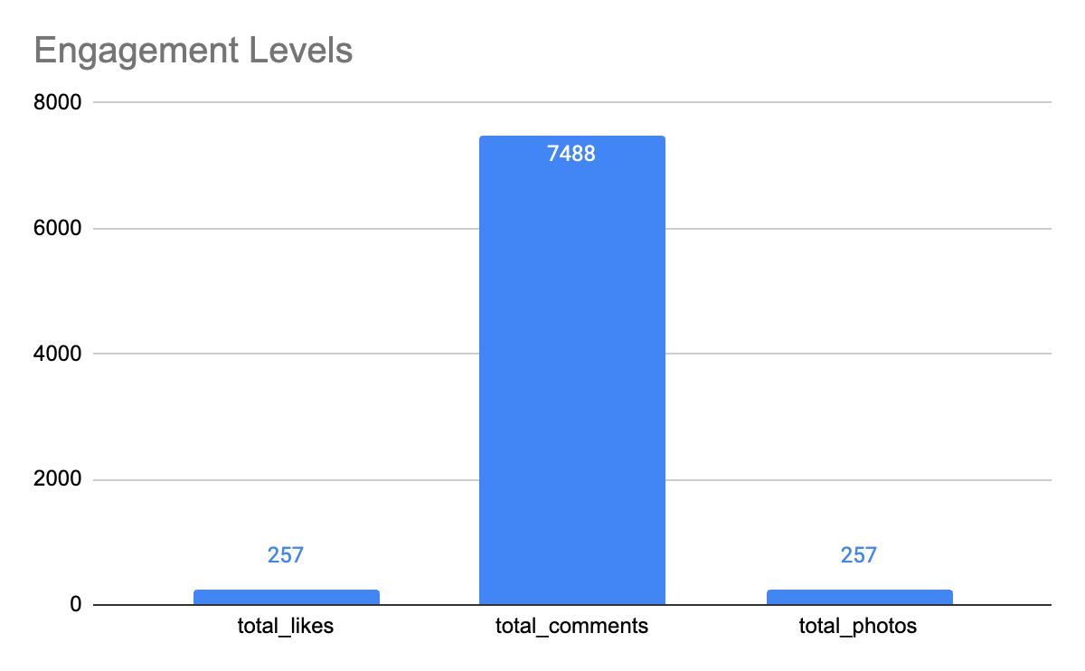
User Engagement Insights
Findings:
High engagement with reels over traditional posts.
Peak activity observed between 7–9 PM.
Users prefer visual content (images, short videos) over text-heavy posts.
Recommendations:
Increase focus on reels and stories.
Schedule posts during peak activity hours.
Invest in visually appealing, high-quality content.

Slide 8
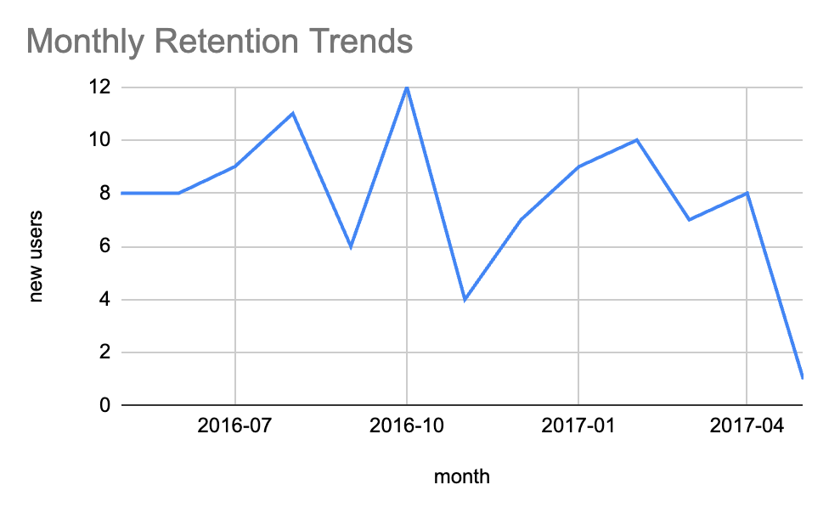
User Retention Analysis
Key Insights:
High churn rate among inactive users after 30 days.
Loyal users show preference for personalized content.
Retention Strategies:
Implement loyalty programs (badges, exclusive content).
Use personalized recommendations based on user history.
Send re-engagement notifications for inactive users.

Slide 9
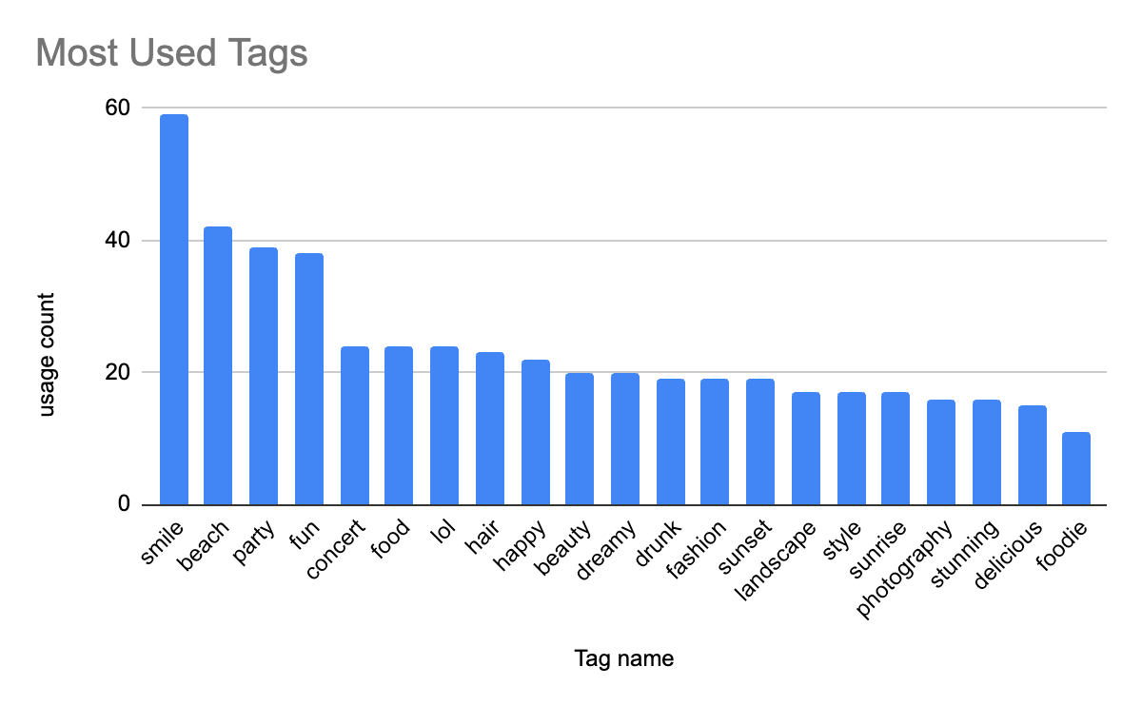
User Acquisition Analysis
Insights:
New user signups primarily through referral links and influencer marketing.
High growth in regions like Southeast Asia and South America.
Acquisition Strategies:
Partner with region-specific influencers.
Introduce referral bonuses and region-specific campaigns.
Optimize ads targeting emerging markets.

Slide 10
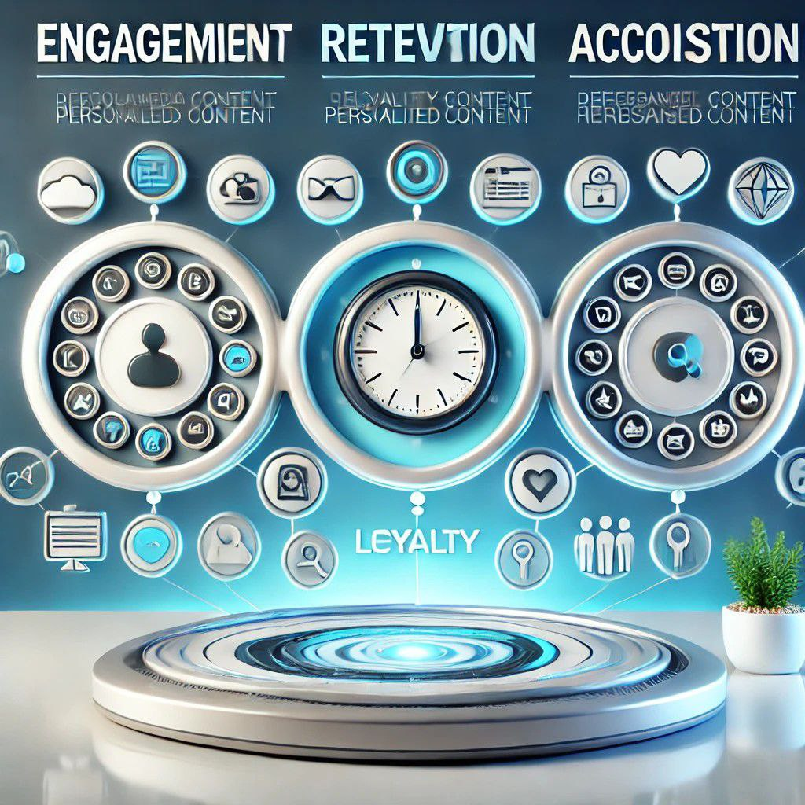
Recommendations
Boost Engagement: Focus on reels and stories, schedule posts during 7–9 PM, and introduce interactive features like polls and Q&A.
Enhance Retention: Implement loyalty programs, use personalized content recommendations, and send re-engagement notifications for inactive users.
Drive Acquisition: Partner with influencers in growth regions, enhance referral bonuses, and optimize ads for emerging markets.

Slide 11
Conclusion
Data-Driven Marketing: Leveraging Instagram user data enables the creation of personalized and impactful marketing strategies.
Enhanced Engagement: Insights from data analysis help boost user interaction and satisfaction through targeted campaigns.
Improved Retention: Focused retention strategies, such as loyalty programs and re-engagement notifications, foster long-term user loyalty.
Strategic Acquisition: Data insights optimize user acquisition efforts, ensuring efficient targeting of potential users.
Sustainable Growth: Continuous evaluation and refinement of strategies ensure sustained user engagement, retention, and platform growth.

Slide 12
